Slide 1
IIR Filters in FPGAs
Dominic Meads

Slide 2
Prerequisites
Basic signal processing (FIR vs IIR, impulse response, etc.)
Knowledge of Verilog
Access to MATLAB if desired
Access to FPGA simulator of your choice (I’m using AMD Vivado)

Slide 3
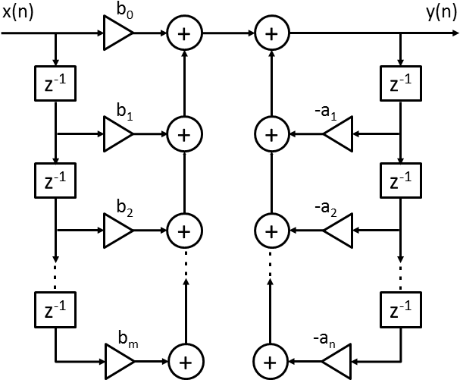
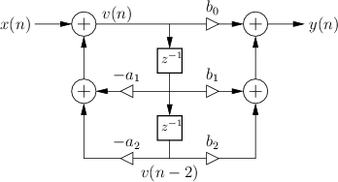
IIR Filter Structures
Direct Form-II
Direct Form-I

Slide 4
Focus: Direct Form-I
Why?
“It is a very useful property of the direct-form I implementation that it cannot overflow internally in two's complement fixed-point arithmetic:
As long as the output signal is in range, the filter will be free of numerical overflow.”
Source: Direct-Form I

Slide 5
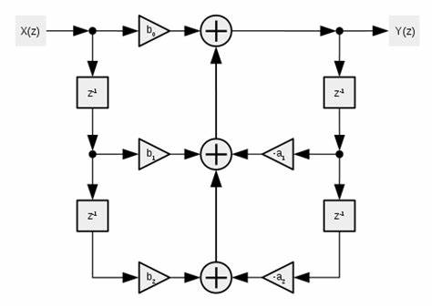
IIR Filters: Second-Order Sections
Second-order sections, also known as biquads (short for bi-quadratic)
“the cascaded-biquad design is less sensitive to coefficient quantization than a single high-order IIR, particularly for lower cut-off frequencies”
Design IIR Filters Using Cascaded Biquads - Neil Robertson
Direct Form-I Biquad

Slide 6
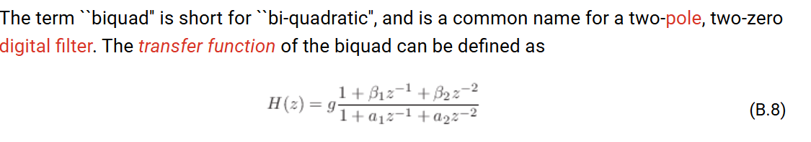
IIR Filters: Second-Order Sections
The BiQuad Section | Introduction to Digital Filters

Slide 7
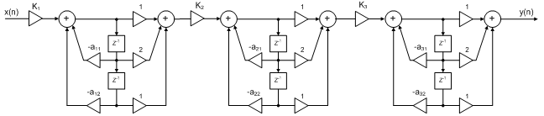
IIR Filters: Second-Order Sections
Cascade three “biquads” to create a 6th order IIR filter that is less sensitive to coefficient rounding error
Note: Picture is not Direct Form-1

